Slide 1
Juniors or Seniors, Who Will Stand?
Neither of them will stand because of their code
MAY 2026

Slide 2
Contents
01
The Junior
02
The Senior
03
The Balance Sheet
04
The Human Skills

Slide 3
Both stared at the same AI revolution and felt the same cold wind.
The setup

Slide 4
The Engineer Shapes
Warming up

Slide 5
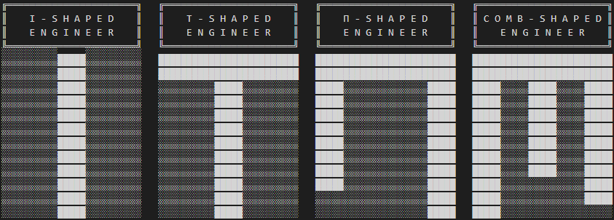

Slide 6
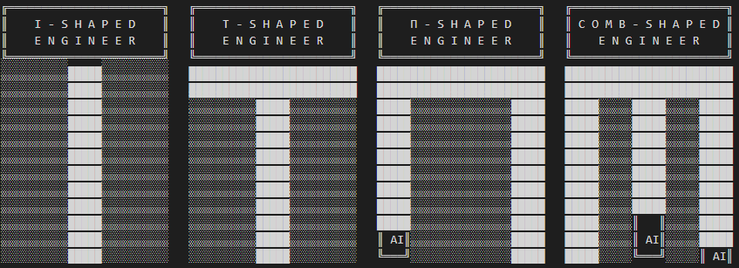

Slide 7
The Junior
Everything to prove — and now the bar has been raised

Slide 8

FIRST WEEK ON THE JOB
The Junior Developer
8th semester student, first assignment: Informix stored procedures for payroll
He was the cockiest, proudest student in class — straight A's, full of confidence.
Day one on a real project: zero knowledge of Informix, zero knowledge of UNIX, zero knowledge of payroll. Ego shattered on the floor.
But also thrilled by every new discovery, learning an insane amount, getting paid.

Slide 9
The University gives you the confidence the real world will destroy in the first week.
The junior reality

Slide 10
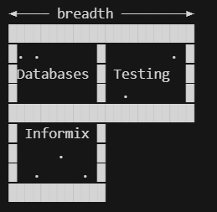
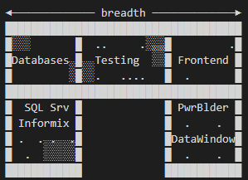
The Junior's Shape Evolution
Diverse challenges build versatile engineers
- Project 1: Informix + UNIX → first database depth
- Project 2: PowerBuilder + SQL Server → breadth begins
- Each new project adds a dimension to the shape
- No-shape → Pi-shape without even noticing it
- Feeling a little lost, but less, every time

Slide 11
The Traditional Junior Role
- Hired for simple, repetitive, boring tasks - The task itself matters less than mentorship
- Unit tests, on-call support, documentation, CRUDs
- Safe tasks that won't break the system while trust builds
- Two rules:
Rule #1: Must be good at something
Rule #2: Must be cheap
- AI disrupts both of those assumptions

Slide 12
Even if AI does the repetitive stuff, someone has to point it in the right direction.
The junior's new value

Slide 13
Can a Junior Get a Job Today?
- AI is not equally adopted across all companies or projects
- Spec debt is real: dozens of missing specs in every project
- CRUD specs don't write themselves — still a junior's job
- Companies expect Pi-shaped skills straight out of school
- Rule #3 for hiring: must be good using AI

Slide 14
The bar has been raised. The single-language quiet junior is not enough anymore.
New expectations

Slide 15
Don't learn how to code — learn how to tell the machine what to code.
The junior's shift

Slide 16
Lessons for the Junior Job-Seeker
- Every day without learning something new is a wasted day
- Relationships take you further than grade notes
- Stay humble, stay hungry — there's always someone better
- Don't stay too long on the shore, don't dive too deep
- Networking; knowledge without connections goes nowhere

Slide 17
The Senior
Everything to lose — especially if you stopped growing

Slide 18
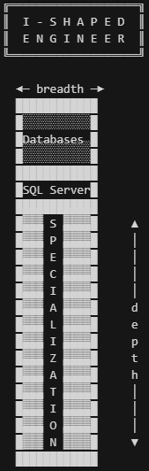
THE SPECIALIZATION TRAP
The SQL Server Master
Can tune any query — but microservices don't use SQL Server
He knows every trick. Every index, every execution plan, every edge case in a complex query. His craft is undeniable.
But SQL Server is enterprise and monolithic — and microservices run on PostgreSQL, NoSQL, and lightweight stores. It's not that he is technically bad.
He is architecturally unfashioned. Not the job's fault. Not the world's fault. A consequence of personal decisions made over years.

Slide 19
THE COMFORT ZONE TRAP
The University Colleague
Joined the city's largest utility company — the dream job in the 90s
Benefits, stability, prestige. Two decades later she feels stuck. The political game to get promoted isn't fair. No matter what technology she masters, she cannot decide, cannot experiment, cannot feel lost anymore.
She became valuable — but only to that one company. Getting hired by an AI-first company is not possible. A ramp-down would be catastrophic.

Slide 20
Even working on a modern project makes you outdated.
The senior's blind spot

Slide 21
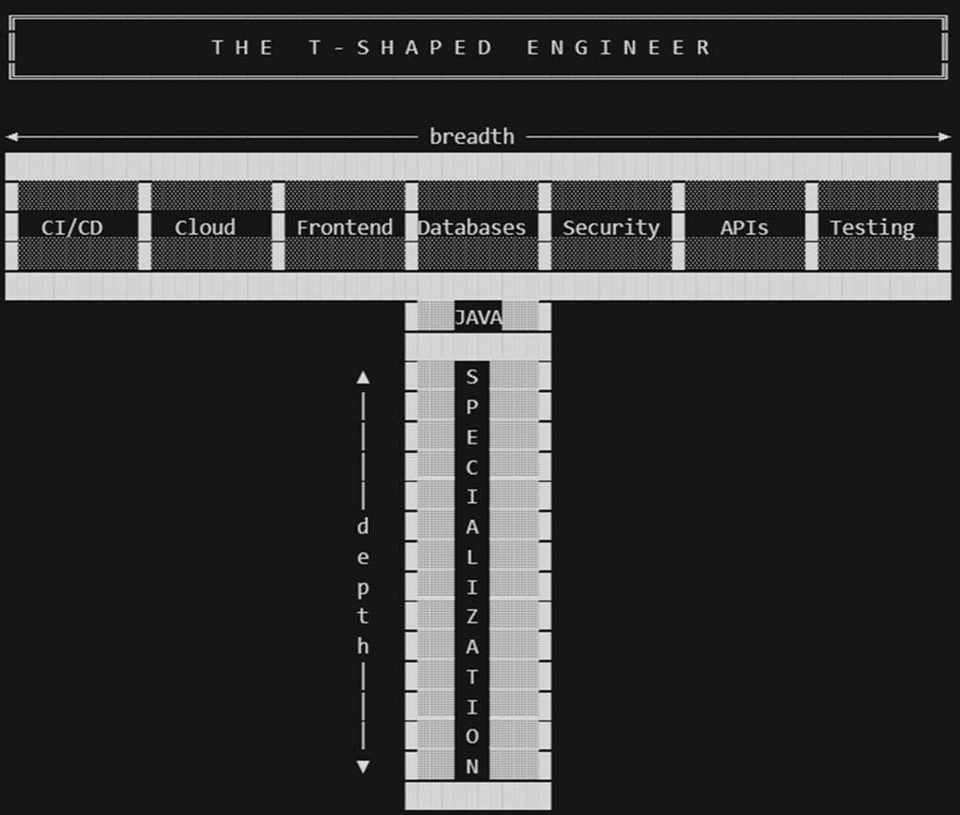
Why Seniors Become Outdated
Only exposure to diverse challenges builds breadth
- Projects take years to build, release, and mature
- New technologies emerge during that time
- Deep focus on delivery creates a narrow window on trends
- The comfort of expertise breeds the illusion of being current
- Years of experience ≠ M-shaped engineer

Slide 22
Your professional career is a consequence of personal decisions made during years of work.
Ownership

Slide 23
Are Seniors Being Replaced by AI?
- AI layoffs are real — but so is regret after them
- Seniors carry the *why* behind every system decision
- Non-technical users don't know: feature flags, canary deploys, PRs, linters
- A good senior directing AI is worth more than AI alone
- Key value: AI innovations that bring measurable value to the company

Slide 24
New teams are expected to be smaller, but more productive.
The AI augmentation model

Slide 25
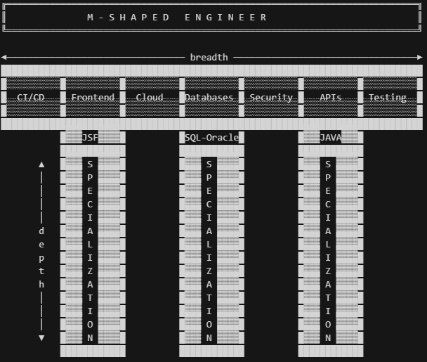
Senior M-Shaped Engineer has More Possibilities

Slide 26
Years of experience don't necessarily make you an M-Shaped engineer, only the exposure to diverse technological experiences

Slide 27
Augment, Don't Replace
Keeping and augmenting people beats reducing them
- Option A: Lay off 500 — same output, lower cost
- Option B: Keep 1000 + AI — double output, higher revenue
- Option C: Do nothing — no gain, falling behind
- Speaking a language doesn't make you a great writer
- AI codes it; the Senior ensures it doesn't break

Slide 28
It's like self-parking cars. You still need to know how to park.
The senior's responsibility

Slide 29
The Balance Sheet
Neither side has earned a safe place yet

Slide 30
Juniors in the AI Era
✅ Cost-effective, high energy, fast AI adopters
✅ No fear of asking obvious questions
❌ Without Design Patterns knowledge, AI output is unmaintainable
❌ Can't handle production pressure without scar tissue
❌ Needs direction — even with AI doing the work

Slide 31
Seniors in the AI Era
✅ Battle-tested depth, architectural thinking, multiplier effect
✅ Institutional memory — knows the *why* behind every decision
❌ Risk of I-shape: deep but narrow in yesterday's stack
❌ Resistance to change, complacency with learning
❌ Overcaution as a blocker when teams need to move fast

Slide 32
An AI is a senior in every language and a junior in every codebase.
The real AI limitation

Slide 33
What AI Cannot Replace (Yet)
- 166 microservices, 328 tables — only a senior explains *why*
- AI learns from training and the codebase, not company history
- Business context, team dynamics, past failures are invisible to AI
- Customer understanding is the most critical task in any project
- Non-technical users lack the controls that keep systems stable

Slide 34
The Human Skills
The foundation neither juniors nor seniors can skip

Slide 35
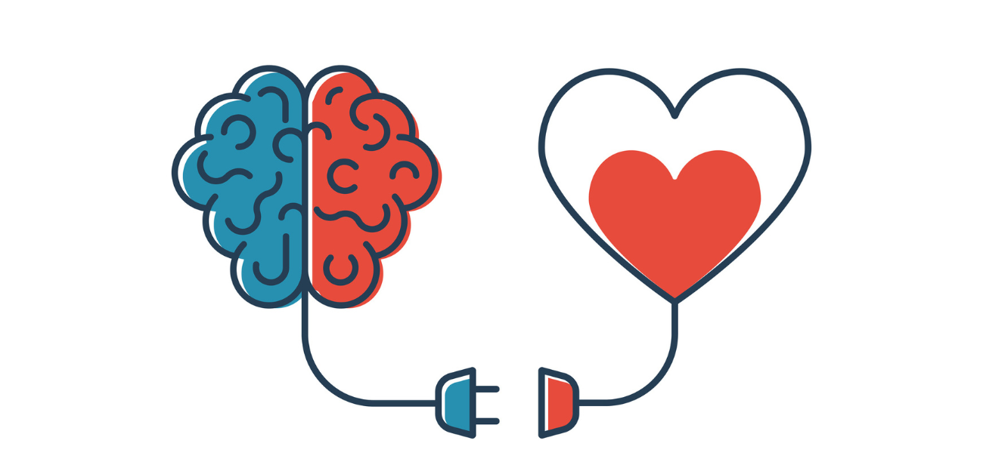
A PERSONAL STORY
The Architect with Zero EQ
Java Enterprise Architect certified — but missing everything that matters
The certification was real. The skills were not. Little charisma, no team collaboration, ivory-tower mentality. Brilliant at presentations but no business communication, no storytelling.
Anxiety sent him to the emergency room before every production release.
Can you imagine an architect who struggles to make a decision? Therapy saved him. And so did being honest about what he lacked.

Slide 36
The Human Skills Foundation
The layer beneath every technical shape
- THINKING: Strategic problem solving, decision making
- COMMUNICATION: Storytelling, presentation, business communication
- COLLABORATION: Team, stakeholder, diplomacy
- INFLUENCING OTHERS: Leadership, persuasion, ownership
- MULTIPLY: Mentoring, coaching, knowledge sharing

Slide 37
Without human skills, anyone could be replaced by AI — even the M-Shaped.
The real differentiator

Slide 38
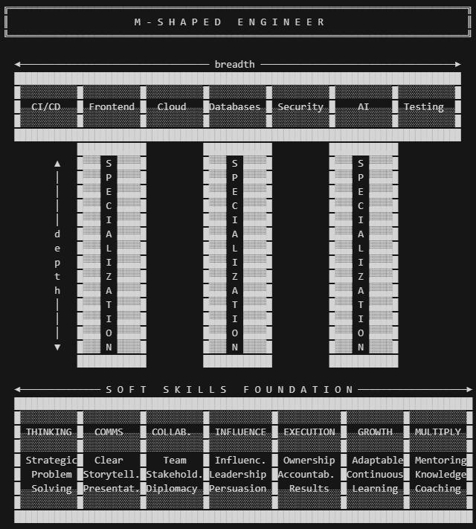
Who Will Actually Stand
Technical shape + soft skills + AI as a multiplier
- M-shaped breadth: multiple deep specializations across domains
- AI fluency: directing, validating, and catching AI failures
- Human skills foundation: the layer AI cannot emulate
- Continuous exposure to new challenges — by personal choice
- Building relationships, not hiding behind the Team Lead

Slide 39
The era of the geek in a dark room is gone. Go find the next story.
The call to action

Slide 40
Thank you!
Edgar Alvarez
Head of Core Engineering
edgar_alvarez1@epam.com

